Slide 1

Learning Objective
I will add and subtract negative integers.
Enter quietly, please be ready with the following on your desk:
Whiteboard
Whiteboard marker
Exercise Book
Pencil, pen, ruler and red pen
Diary
Calculator
Device – charged or borrowed from Library before maths

Slide 2


Daily Review
Daily Review
Are the following words positive or negative?
Profit After Down Up Withdraw
Owe Loss Deposit

Slide 3
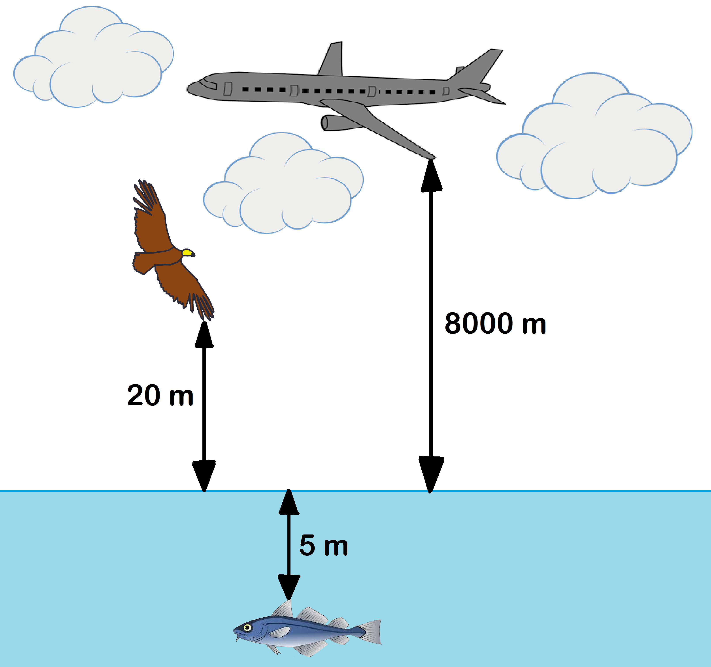
Daily Review
CFU
How would you represent the fish’s position as an integer?
-5
CFU
How far is the bird from the fish?
20 + 5 = 25 m
CFU
What is the distance between the plane and the bird?
8 000 - 20 = 7 980 m
CFU
How far apart are the plane and the fish?
8 000 + 5 = 8 005 m

Slide 4



Daily Review
HINT
Adding means moving right. →
Subtracting means moving left. ←
Think of it like tug of war around zero.
-3 + 5
There are 3 people on the negative side.
= +2
There are 5 people on the positive side.
= 2
Which side wins?
Will the answer be positive or negative?
Using the column stacking method,
put the large number on top.
Positive
5
- 3
2

Slide 5
Daily Review
HINT
Adding means moving right. →
Subtracting means moving left. ←
Think of it like tug of war around zero.
7 - 13
There are 7 people on the positive side.
= -6
There are 13 people on the negative side.
Will the answer be positive or negative?
Using the column stacking method,
put the large number on top.
Negative
13
- 7
6

Slide 6
Daily Review
HINT
Adding means moving right. →
Subtracting means moving left. ←
Think of it like tug of war around zero.
-2 - 6
There are 2 people on the negative side.
= -8
There are 6 more people on the negative side.
Will the answer be positive or negative?
Using the column stacking method,
put the large number on top.
Negative
6
+ 2
8

Slide 7
Daily Review
HINT
Adding means moving right. →
Subtracting means moving left. ←
Whiteboards
-9 + 14
13 - 19
-48 - 62
-36 - 21
Will the answer be positive or negative?
Using the column stacking method,
put the large number on top.

Slide 8

Daily Review
HINT
Use the divisibility laws and count your way up.
e.g. Is it divisible by 2? By 3? By 4?…
Draw factor trees of the following numbers.
22
18
42
Whiteboards
2
11
22 = 2 x 11

Slide 9
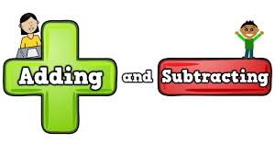
Learning Objective
CFU
What will we learn today?
CFU
I will add and subtract negative integers.
How will you know that you are successful?
Success Criteria
At the end of the lesson, I will be able to:
Decide whether an answer will be positive or negative.
Add negative integers.
Subtract negative integers.

Slide 10
Adding and Subtracting Negative Integers
Concept/Skill Development
(+3) + (-5)
= 3 - 5
Start here
Face this direction
‘+’ means move FORWARDS,
‘-’ means move BACKWARDS

Slide 11
Concept/Skill Development
Adding and Subtracting Negative Integers
(-3) - (-5)
= -3 + 5
Start here
Face this direction
‘+’ means move FORWARDS,
‘-’ means move BACKWARDS

Slide 12
Adding and Subtracting Negative Integers
Concept/Skill Development
(+2) - (-3)
= 2 + 3
Start here
Face this direction
‘+’ means move FORWARDS,
‘-’ means move BACKWARDS

Slide 13
Adding and Subtracting Negative Integers
Concept/Skill Development
(-1) + (-4)
= -1 - 4
Start here
Face this direction
‘+’ means move FORWARDS,
‘-’ means move BACKWARDS

Slide 14
Adding and Subtracting Negative Integers
Concept/Skill Development
(0) - (+3)
= 0 - 3
Start here
Face this direction
‘+’ means move FORWARDS,
‘-’ means move BACKWARDS

Slide 15
Concept/Skill Development
HINT
Adding means moving right. →
Subtracting means moving left. ←
Think of it like tug of war around zero.
2 + (-4)
HINT
Like symbols = +
Unlike symbols = -
= 2 - 4
There are 2 people on the positive side.
= -2
There are 4 people on the negative side.
Simplify the middle.
Will the answer be positive or negative?
Using the column stacking method,
put the large number on top.
Negative
4
- 2
2

Slide 16
Concept/Skill Development
HINT
Adding means moving right. →
Subtracting means moving left. ←
Think of it like tug of war around zero.
(-3) + (-5)
HINT
Like symbols = +
Unlike symbols = -
= -3 - 5
There are 3 people on the negative side.
= -8
There are 5 more people on the negative side.
Simplify the middle.
Will the answer be positive or negative?
Using the column stacking method,
put the large number on top.
Negative
5
+ 3
8

Slide 17
Concept/Skill Development
HINT
Adding means moving right. →
Subtracting means moving left. ←
Think of it like tug of war around zero.
Whiteboards
8 + (-9)
HINT
Like symbols = +
Unlike symbols = -
There are 8 people on the positive side.
There are 9 people on the negative side.
Simplify the middle.
Will the answer be positive or negative?
Using the column stacking method,
put the large number on top.

Slide 18
Concept/Skill Development
HINT
Adding means moving right. →
Subtracting means moving left. ←
Think of it like tug of war around zero.
Whiteboards
7 – (-6)
HINT
Like symbols = +
Unlike symbols = -
There are 7 people on the positive side.
There are 6 more people on the positive side.

Slide 19
Concept/Skill Development
HINT
Adding means moving right. →
Subtracting means moving left. ←
Think of it like tug of war around zero.
Whiteboards
(-18) – (-12)
HINT
Like symbols = +
Unlike symbols = -
There are 18 people on the negative side.
There are 12 people on the positive side.

Slide 20
Guided Practice
HINT
Subtracting means moving left. ←
Adding means moving right. →
Whiteboards
4 – (-9)
(-17) – (-8)
(-2) + (-9)
8 – (-12)
(-41) + (-14)
16 – (-21)
(-50) – (-12)
(-64) – (-81)
Will the answer be positive or negative?
Using the column stacking method,
put the large number on top.

Slide 21
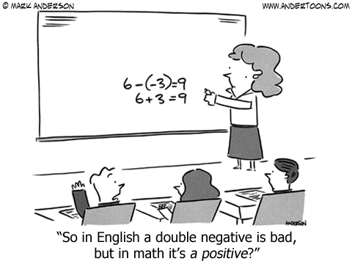
Skill Closure
What have we learnt today?
Lesson Objectives:
I will add and subtract negative integers.
8 – (-9)
= 17

Slide 22


Independent Practice
Mathematics Page Layout
Open your textbooks to:
Chapter 2.6
Questions: 1, 2, 4, 8, 10 (every second column)

